Slide 1


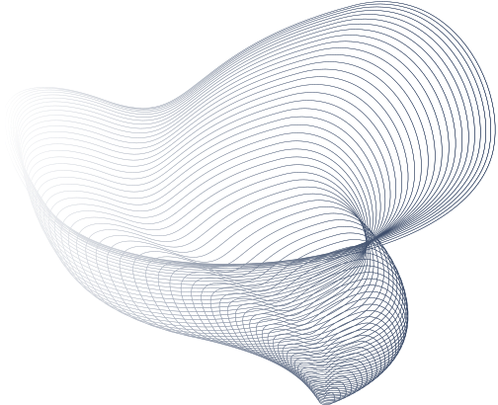
HackTrix’24
Team Name : Wu Tang Clan
Members Name : Vishal S
Sudarsh R M
Narayanan P
Pravin J
Varun S

Slide 2

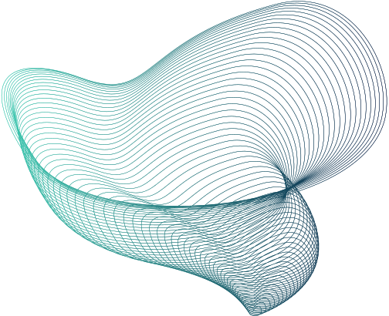
Arduino Based Solar Tracking System
Introduction
Project Overview
Solar energy is a clean, easily accessible and abundantly available alternative energy source in nature. Getting solar energy from nature is very beneficial for power generation. Using a fixed Photovoltaic panels extract maximum energy only during 12 noon to 2 PM which results in less energy efficiency. Therefore, the need to improve the energy efficiency of PV solar panel through building a solar tracking system cannot be over-emphasized. Photovoltaic panels must be perpendicular with the sun in order to get maximum energy. The methodology employed in this work includes the implementation of an Arduino based solar tracking system. Light Dependent Resistors (LDRs) are used to sense the intensity of sunlight and hence the PV solar panel is adjusted accordingly to track maximum energy. The mechanism uses a servo motor to control the movement of the solar panel. The microcontroller is used to control the servo motor based on signals received from the LDRs. The result of this work has clearly shown that the tracking solar panel produces more energy compared to a fixed panel

Slide 3

Target Users and market selection
Educational Institutions: Schools, colleges, and universities can use Arduino-based Solar Tracking Systems for educational purposes in STEM (Science, Technology, Engineering, and Mathematics) programs. These systems provide hands-on learning opportunities for students to understand concepts related to solar energy, electronics, programming, and automation.
Agricultural Sector: Farmers and agricultural businesses increasingly use solar energy to power irrigation systems, lighting, and other operations. Solar Tracking Systems can enhance the efficiency of agricultural solar installations, ensuring maximum energy capture throughout the day.
Homeowners and Small Businesses: These users may be interested in implementing solar panels for energy efficiency and cost savings. An Arduino-based Solar Tracking System can help optimize the efficiency of their solar panels by ensuring they are always oriented towards the sun for maximum energy capture.
Environmental Monitoring and Research: Researchers and environmental monitoring agencies may use Solar Tracking Systems to power remote sensors, data collection devices, or monitoring stations in environmentally sensitive areas.
When selecting the market for an Arduino-based Solar Tracking System, it's essential to consider factors such as the target audience's needs, budget, technical expertise, and the competitive landscape. Additionally, market research and validation can help identify the most promising market segments and tailor the product to meet their specific requirements.
The target users and market selection for an Arduino-based Solar Tracking System can vary depending on the specific features, capabilities, and applications of the system. Here's a breakdown of potential target users and markets:
Educational Institutions
Agricultural Sector
Homeowners and Small Businesses

Slide 4


Problems
One major problem of Arduino-based Solar Tracking Systems is their reliance on precise calibration and consistent performance of electronic components over time. Some specific issues includes
Accuracy and Calibration
Reliability and Durability
Complexity and Maintenance
Cost
Explain
Accuracy and Calibration: Ensuring precise tracking of the sun's position requires accurate calibration of sensors and actuators. Variations in component quality, environmental conditions, and calibration drift over time can lead to tracking inaccuracies.
Reliability and Durability: Solar Tracking Systems operate outdoors and are exposed to harsh environmental conditions such as temperature fluctuations, moisture, and dust. Ensuring the reliability and durability of components under such conditions is critical for long-term performance.
Complexity and Maintenance: Arduino-based Solar Tracking Systems involve complex electronic and mechanical components, increasing the potential for failure and requiring regular maintenance. Simplifying the design while maintaining functionality is crucial to reduce complexity and maintenance efforts.
Cost: Implementing a Solar Tracking System with Arduino can incur additional costs for sensors, actuators, and other electronic components compared to fixed solar installations. Balancing the cost of implementation with the potential increase in energy production is essential for cost-effectiveness.

Slide 5


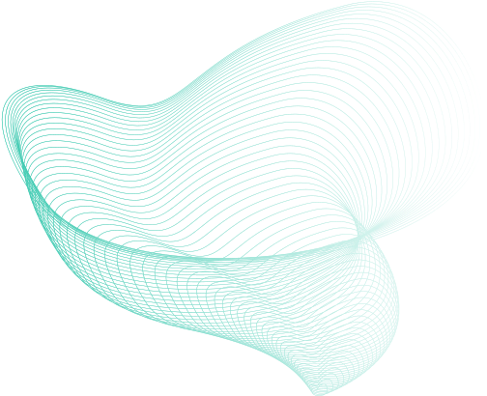
Proposed solution
(Quality sensors,Durable parts,Optimize energy.)
Solution
Accuracy and Calibration:
Implement regular calibration routines to account for sensor drift and maintain tracking accuracy.
Use high-quality sensors with minimal drift and ensure proper shielding from environmental factors.
Incorporate feedback mechanisms to continuously adjust tracking based on real-time performance data.
Reliability and Durability:
Enclose sensitive electronic components in weatherproof enclosures to protect them from moisture, dust, and temperature fluctuations.
Choose durable materials for mechanical components to withstand outdoor conditions.
Conduct regular inspections and maintenance to identify and address any potential issues before they affect performance.

Slide 6
3.Complexity and Maintenance:
Simplify the design by minimizing the number of moving parts and reducing points of failure.
Provide clear documentation and user-friendly interfaces for calibration and maintenance procedures.
Implement remote monitoring and diagnostics capabilities to identify and address issues without physical intervention whenever possible.
4.Cost:
Balance cost considerations with performance requirements by selecting components that offer the best combination of quality and affordability.
Explore cost-saving measures such as using open-source hardware and software, or sourcing components from reputable suppliers.
Consider the long-term benefits of increased energy production and potential cost savings when evaluating the overall return on investment.
(Low-power parts, Wise choices,Wise choices)
…

Slide 7
Future work
(Potential features, plans for scaling)
Designing the system to be scalable and modular, allowing for easy expansion or adaptation to accommodate larger solar arrays or different types of tracking mechanisms.
Explain
Future work on an Arduino-based Solar Tracking System could encompass several avenues for improvement and expansion. Firstly, there's room for developing more advanced tracking algorithms to optimize solar panel orientation based on various factors like weather conditions and seasonal changes. Integration of machine learning techniques could further enhance tracking accuracy by learning from historical data and environmental variables. Additionally, incorporating Internet of Things (IoT) connectivity would enable remote monitoring, control, and data analysis of the system. Energy storage integration, fault detection algorithms, and scalability considerations are also crucial for maximizing efficiency and reliability. Furthermore, a focus on sustainability through eco-friendly materials and energy-efficient components is essential. Improving user interfaces and exploring opportunities for commercialization and deployment in various market segments would ensure broader accessibility and adoption of the technology. Collaboration with research institutions and industry partners could drive innovation and propel the solar tracking system towards broader adoption in renewable energy applications.

Slide 8
⁠Business Model and Monetization
Explain
The business model for monetizing an Arduino-based Solar Tracking System involves diverse revenue streams. Product sales target residential, commercial, and industrial clients, while subscription services offer ongoing support. Installation and integration services cater to customers seeking professional assistance, and training programs provide educational opportunities. Partnerships with solar panel manufacturers and distributors expand market reach, while data generated can be monetized through licensing or value-added services. By aligning these revenue streams with customer needs, the project can achieve sustainable growth and promote renewable energy adoption.

Slide 9

A solar panel tracking system was designed and implemented. The aim of the solar panel tracking system is to track the positon of the sun for better efficiency of the solar panel has shown in the experimental results. This work can be executed on an industrial scale which be beneficial to developing countries like India and other countries Our recommendation for future works is to consider the use of more sensitive and efficient sensors which consume less power and which are also cost effective. This would increase the efficiency while reducing cost.
Conclusion
(Recap & acknowledgments)
Implemented solar panel tracking system proves beneficial for industrial-scale deployment in regions like Nigeria and Sub-Saharan Africa. Future focus on cost-effective, power-efficient sensors can optimize efficiency. Enhancements in durability, remote monitoring, and partnerships would boost adoption in these areas.

Slide 10
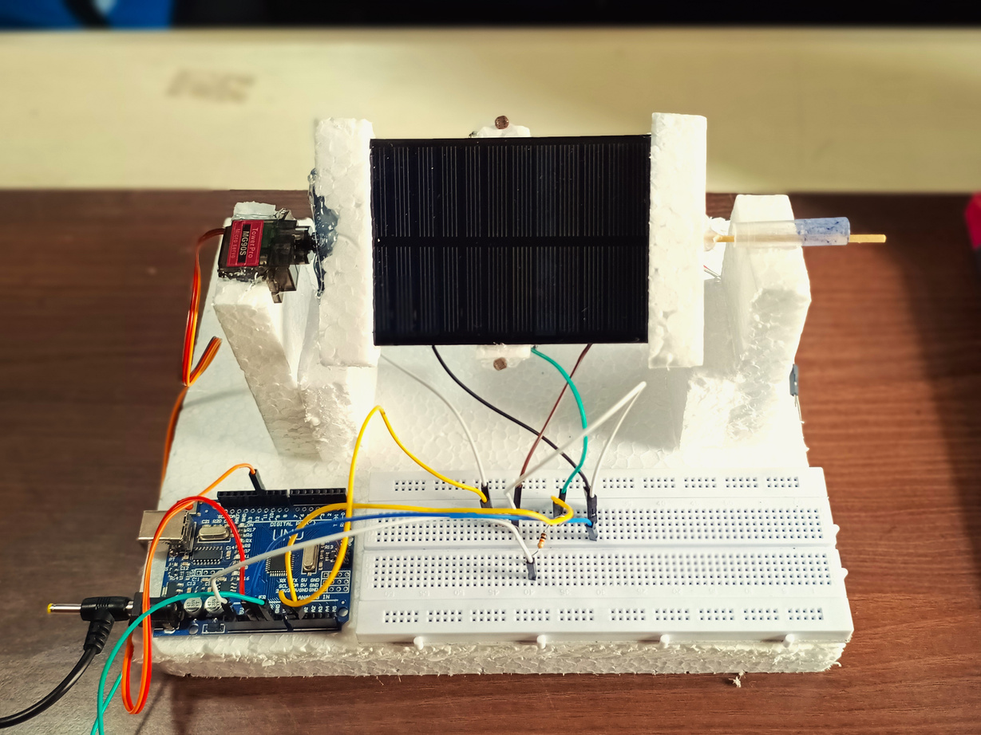
Working Prototype

